Slide 1
Object Oriented System Development
Code Smells, Anti-Patterns and Refactoring
Semester 1, 2019

Slide 2
Next week
Work on either your labs or assignment
Lab marks will be returned at the next session

Slide 3
Bad code smells
Application-level smells
Class-level smells
Method-level smells
Notes:
A code smell is a characteristic in the source code of a program that possibly indicates a deeper problem
Code smells will make your code harder to read, maintain and more likely for your co-workers to hate you

Slide 4
Application-level smells
Duplicated code
Contrived complexity
Shotgun surgery
Dead code
Comments
Notes:
Duplicate code – very similar code that exists in more than one place
Contrived complexity – forced usage of overcomplicated design patterns
The most abused pattern is singleton. It is actually considered a code smell because you are making something global to avoid passing it around
Controls its own creation and lifecycle breaking the single responsibility principle
How we can fix it? You want to understand the design pattern and try to reason if it is really needed in your code
Shotgun surgery – a single change needs to be applied to multiple classes at the same time
Dead code – remove commented code before you push to a version control system
Comments – often used to hide the smell. “Comments are often used as deodorants”
Comments should be used to explain complex logic
Think about refactoring your code so that comments aren’t needed

Slide 5
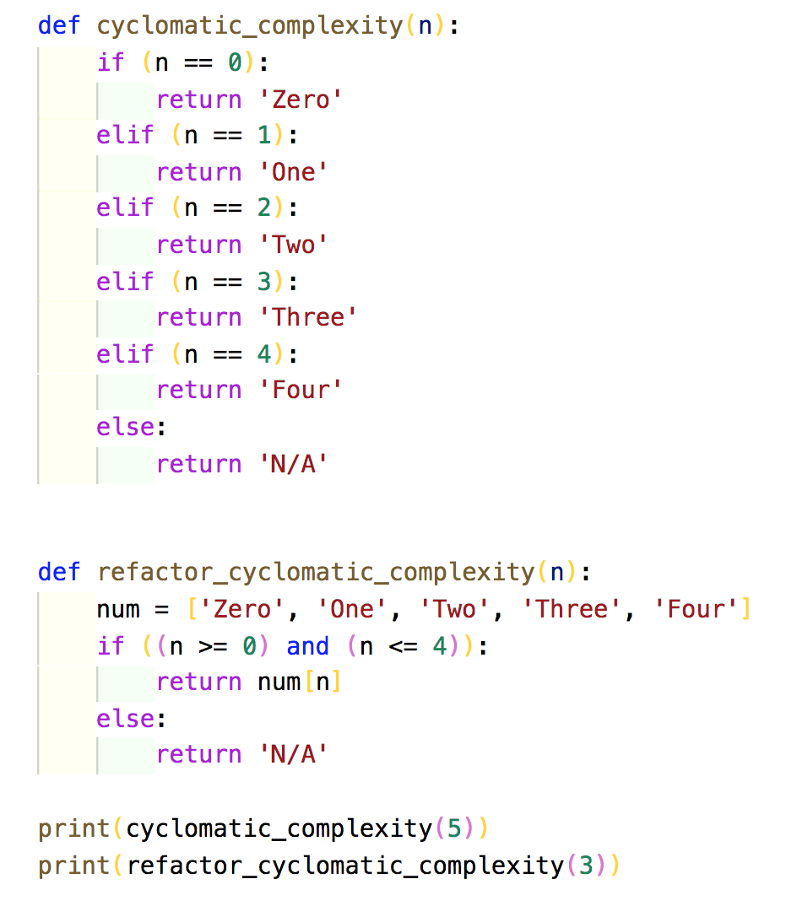
Class-level smells
Large class/God object
Lazy class/freeloader
Excessive use of literals
Cyclomatic complexity
Orphan variable or constant class
Data clumps
Notes:
Large class – a class that has grown too large
Lazy class – a class that does too little
Excessive use of literals – should be named constants, to improve readability and maintainability
Cyclomatic complexity – too many branches or loops
Orphan variable or constant class – a class that has a collection of constants
Data clumps – a group of variables are passed around together in various parts of the program

Slide 6
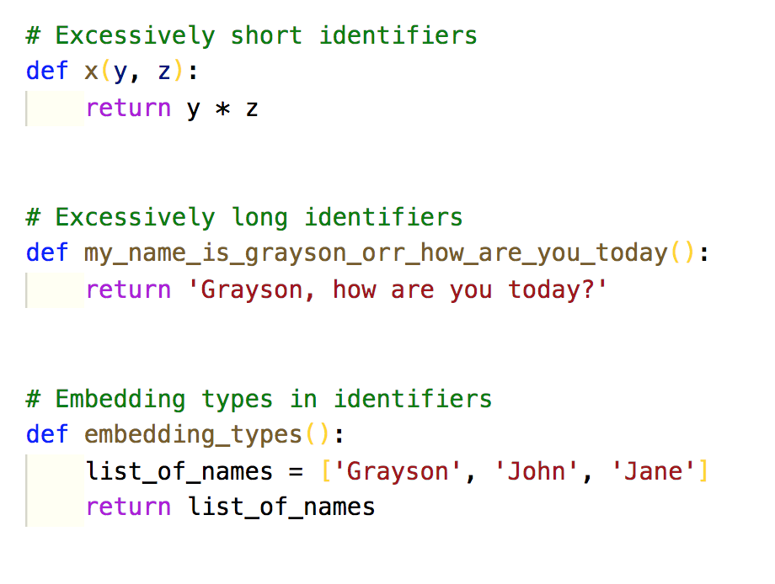
Method-level smells
Too many parameters
Long method
Excessively long identifiers
Excessively short identifiers
Embedding types in identifiers
Excessively long line of code/God line
Notes:
Too many parameters – a long list of parameters
Avoid too many parameters in the methods signature
The recommended number of parameters is 7
I suggest checking your programming language’s style guide for the number
The less the best – readability and maintainability
Long method – a method that has grown too large
The ideal amount of lines is 20
Some say methods with 5 lines of code, indicate that you are breaking up the code too much
Excessively long identifiers – In Python, identifiers should no longer than 32 characters
Excessively short identifiers
Embedding types in identifiers
Excessively long line of code

Slide 7
Anti-patterns
Design patterns
Boat-anchoring
Magic numbers and strings
Spaghetti code
Copy and pasting programming
Not invented here syndrome
Reinventing the square wheel
Notes:
Anti-patterns occur throughout software engineering and is a recurring problem that is usually ineffective and counterproductive
Design patterns
Boat-anchoring - A piece of software or hardware that serves no purpose on the current project
Magic numbers and strings – changing the semantic meaning of a literal value
Spaghetti code
Copy and pasting programming
Not invented here or NIH – reinventing the wheel
Reinventing the square wheel – Failing to adopt an existing solution and instead adopting a custom solution that performs much worse than the existing one. For example, trying to create a search engine that indexes information 10x faster than Google

Slide 8
Refactoring
Restructuring code
Make code readable and maintainable
Code still works
Semantics are preserved
Low in coupling and high in cohesion
Do my unit tests still pass???
Notes:
Restructuring code in a small series of transformations
The goal is to make your code readable and maintainable
You don’t want to be doing massive re-writes
Low in coupling and high in cohesion
Unit tests still pass

Slide 9
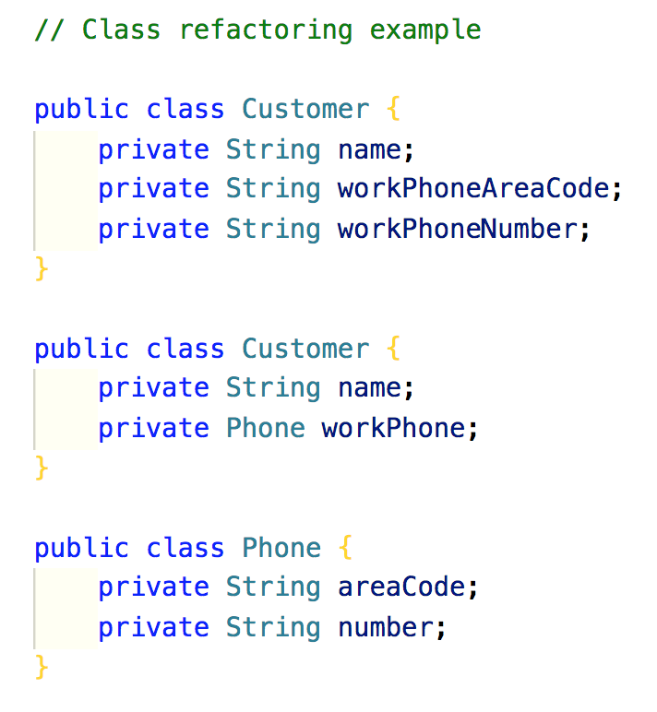
Refactoring code examples – class
Notes:
Refactor this code by breaking the class into two
Having phone details as part of the Customer class is not a realistic OO model, and also breaks the Single Responsibility principle in SOLID

Slide 10
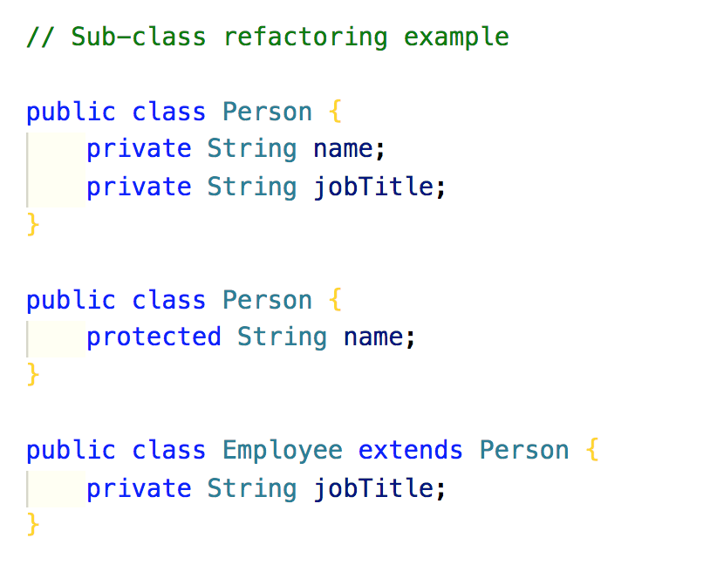
Refactoring code examples – subclass

Slide 11
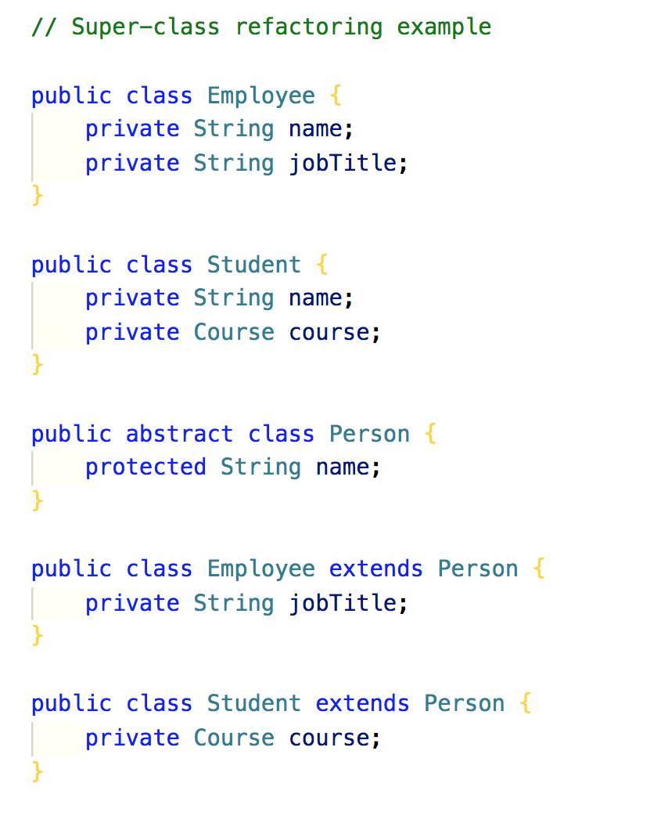
Refactoring code examples – super class

